Slide 1

All Hands
March 2021

Slide 2
Agenda
10 min | People & Accomplishments 👈
30 min | Operational Update
10 min | Mission & Strategy Update
10 min | Q & A session

Slide 3
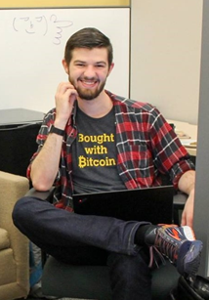
New Hires! (1/2)
Notes:
Here's a picture of me at a hackathon and the three "facts"
I wrote the smart contracts for SatanCoin, an ICO that sold 666 coins
I never learned to use Truffle so I just deploy from Remix
I'm trained as a certified Yoga instructor

Slide 4
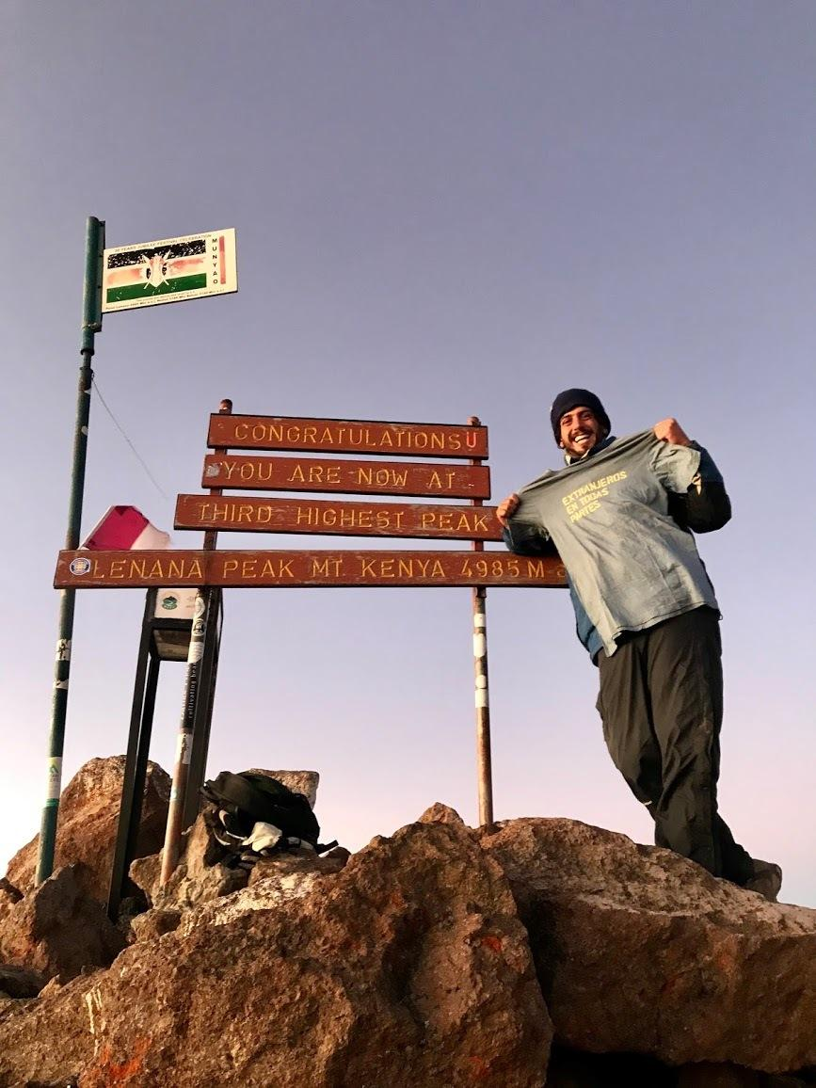
New Hires! (2/2)
Notes:
Two trues:
Galo to explain picture:
My stomach exploded when I was eleven
I have 19 nephews and nieces
I ran my first marathon last year

Slide 5
Anniversaries
🎂
2 Years
1 Year

Slide 6



Captions for your beautiful images
Notes:
given that now I’m in charge of preparing the zep awards, I’ve made the unilateral decision in doing an upgrade

Slide 7
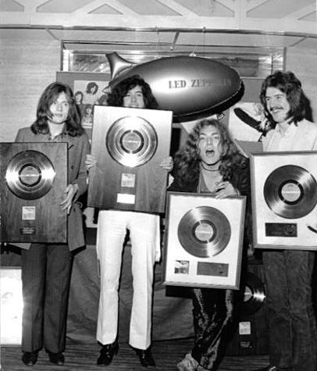

Slide 8
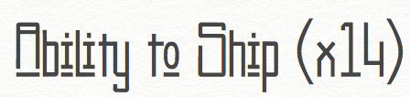
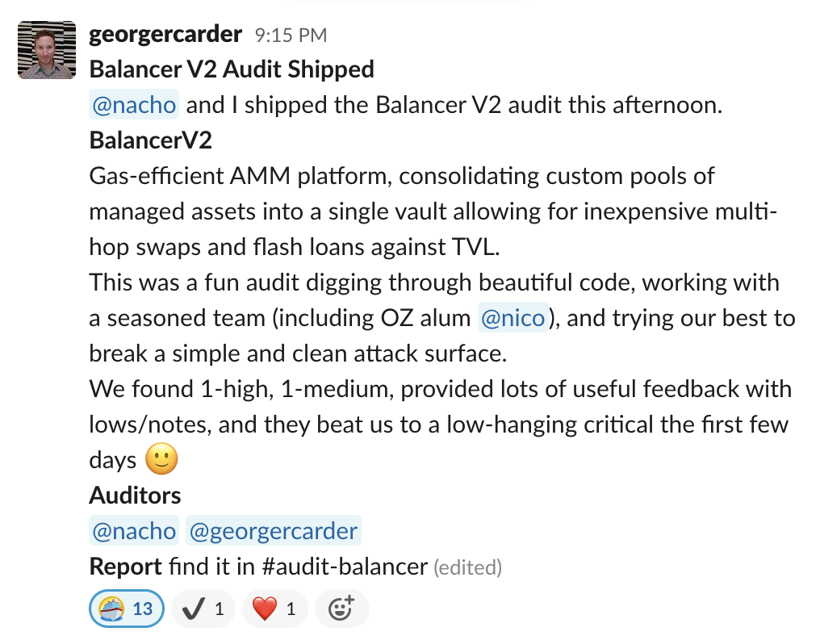
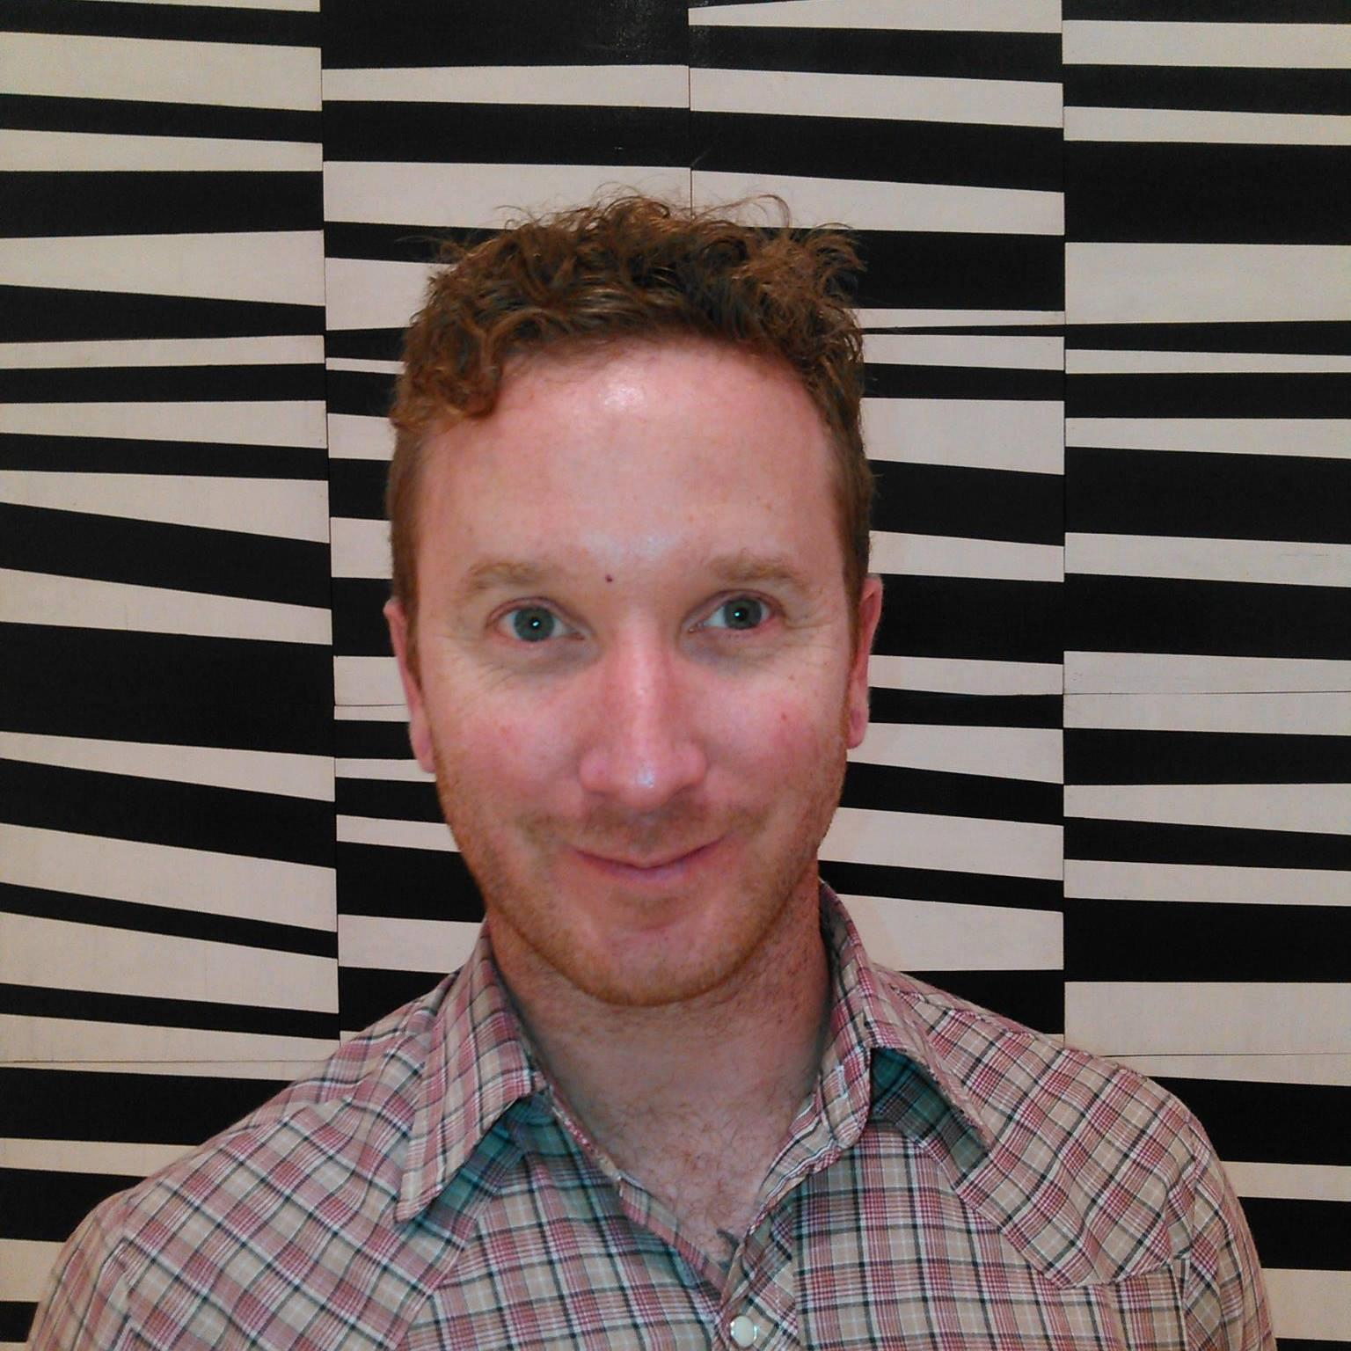
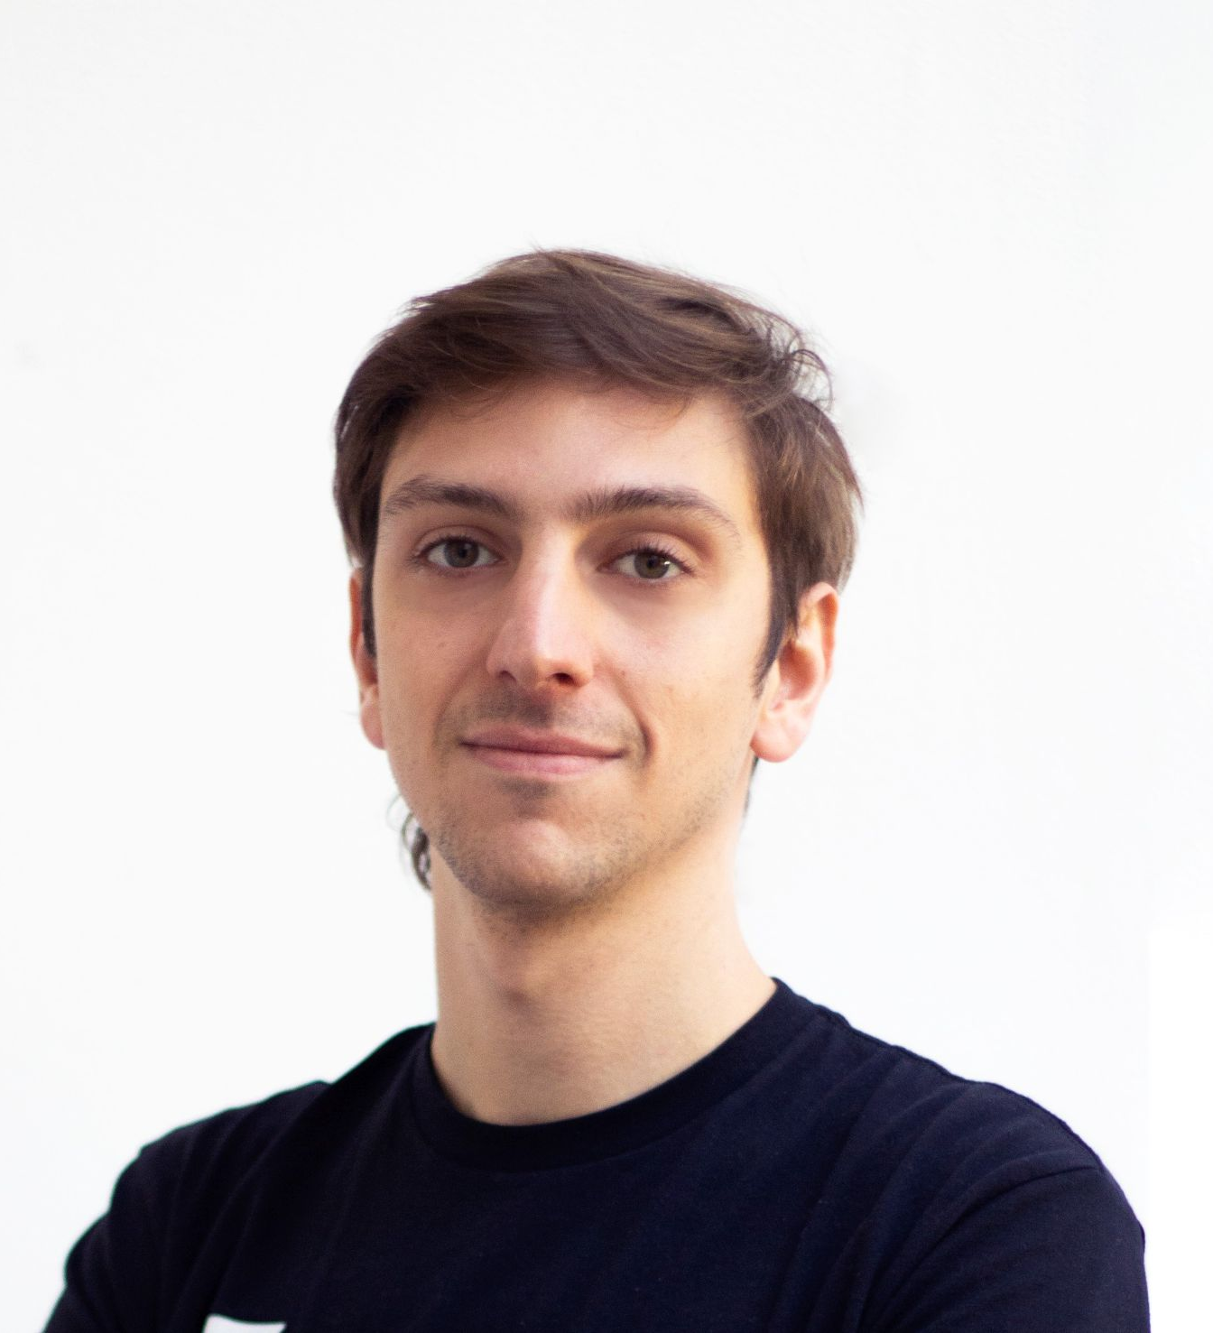
Ability to Ship (x14)
(x13)

Slide 9
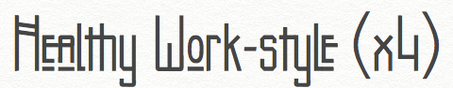
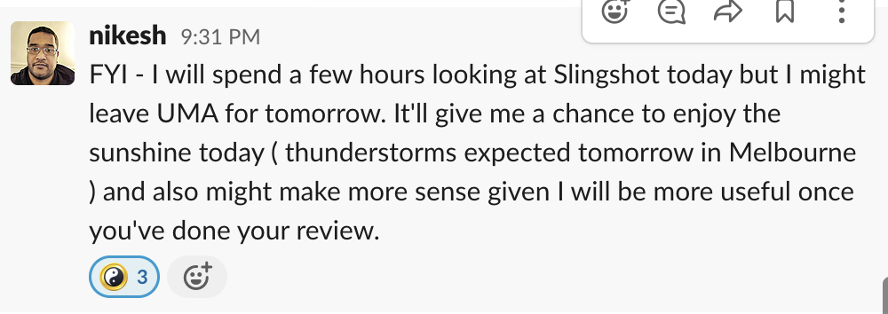
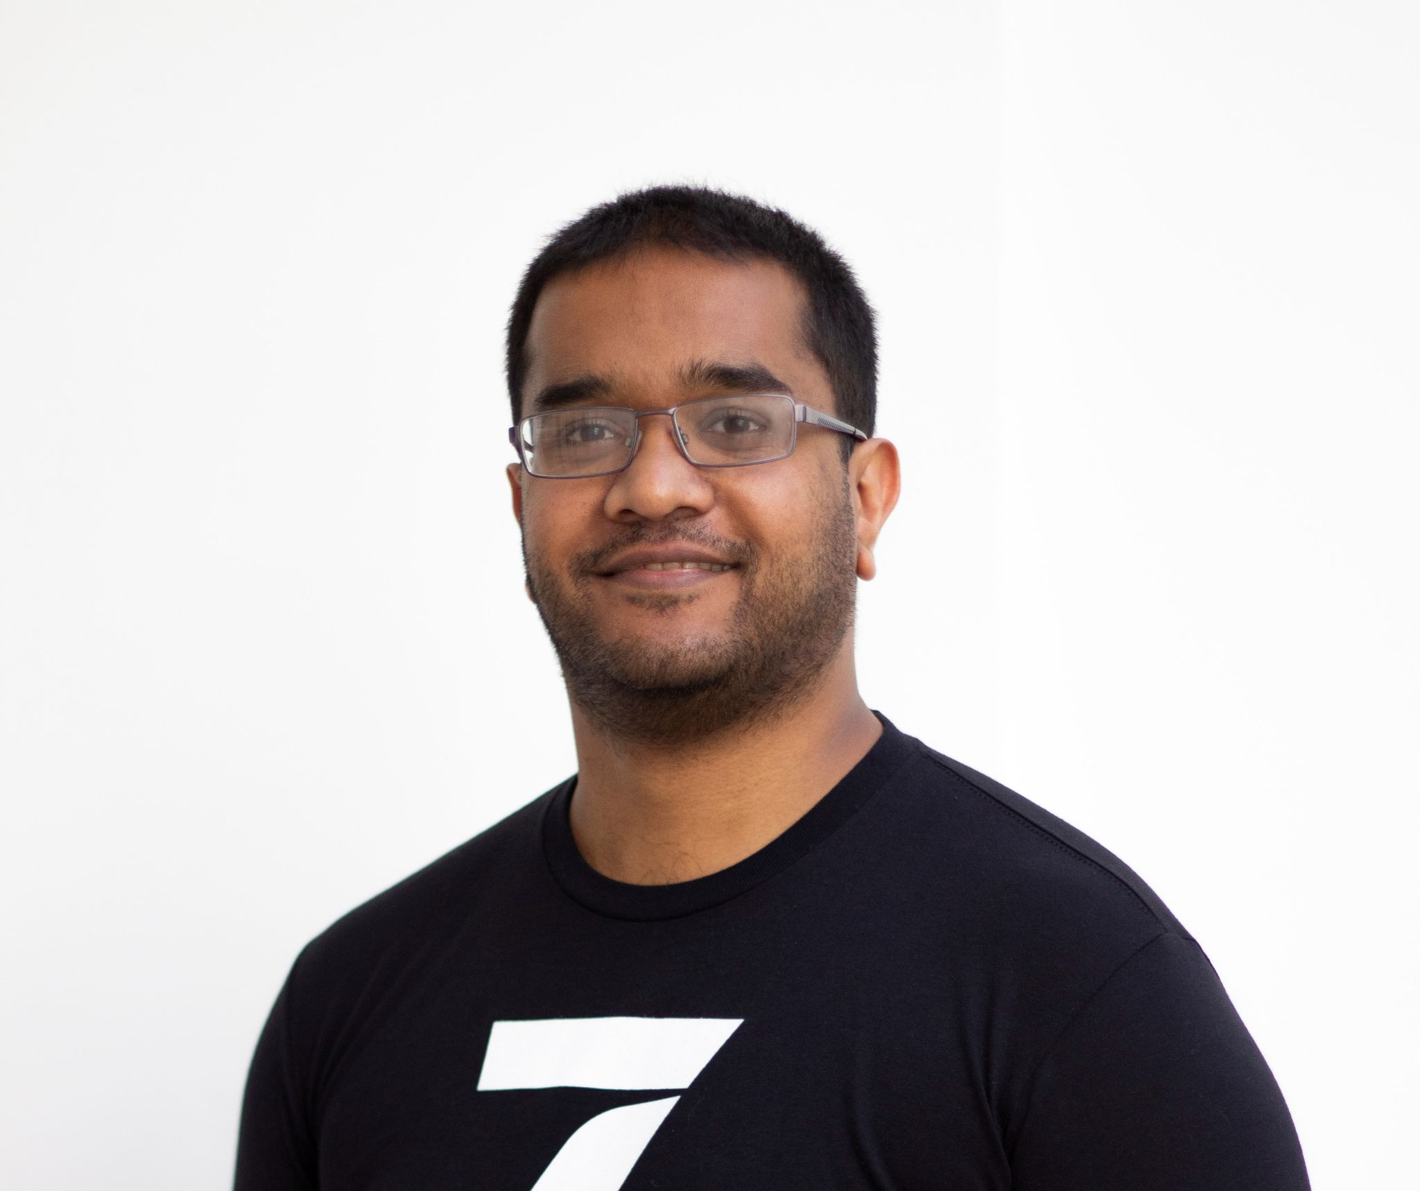
(x3)

Slide 10
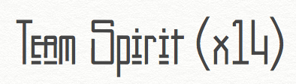
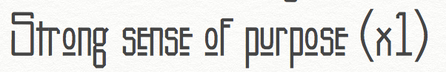
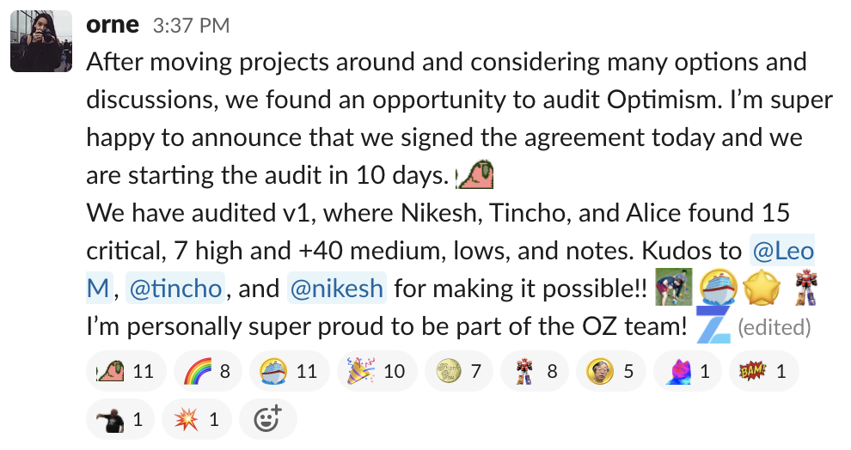
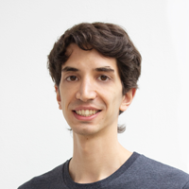
Strong sense of purpose (x1)
(x15)
(x8)

Slide 11
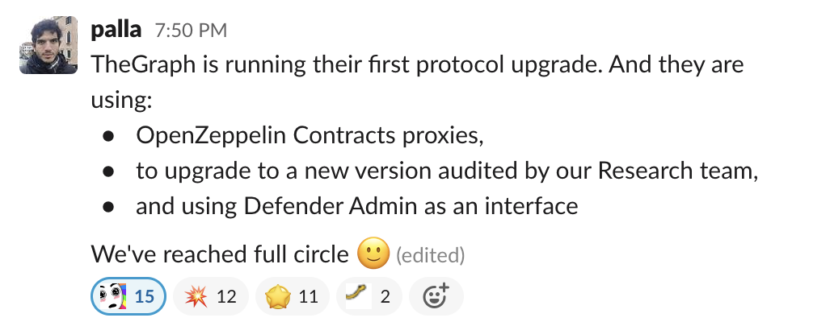
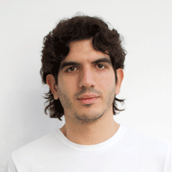
(x11)

Slide 12

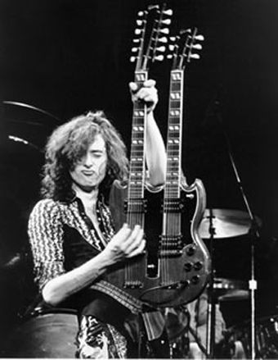

Slide 13
Agenda
10 min | People & Accomplishments
30 min | Operational Update 👈
10 min | Mission & Strategy Update
10 min | Q & A session

Slide 14

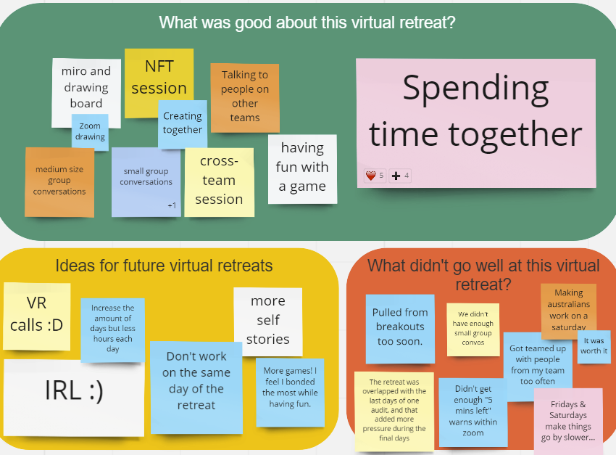




What did we learn from the Virtual Retreat?
😊
☀️
❤️
❤️
❤️
🚀
❤️
🚀
☀️
😊
❤️

Slide 15
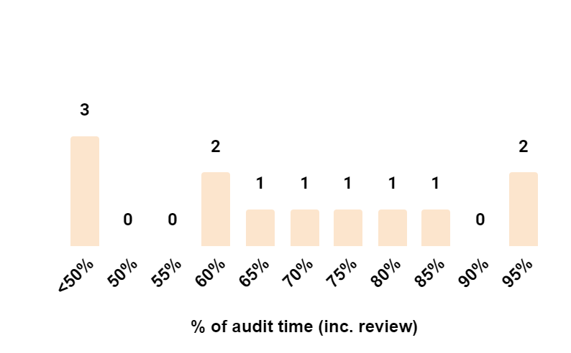
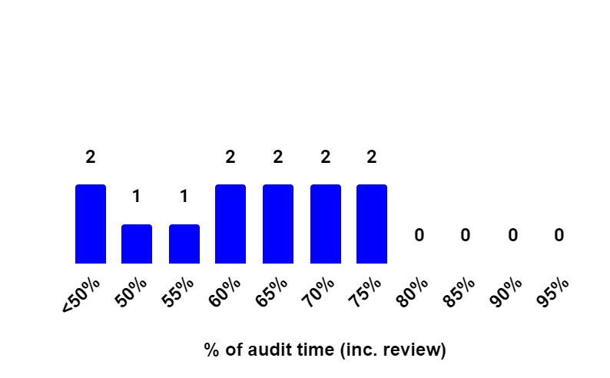
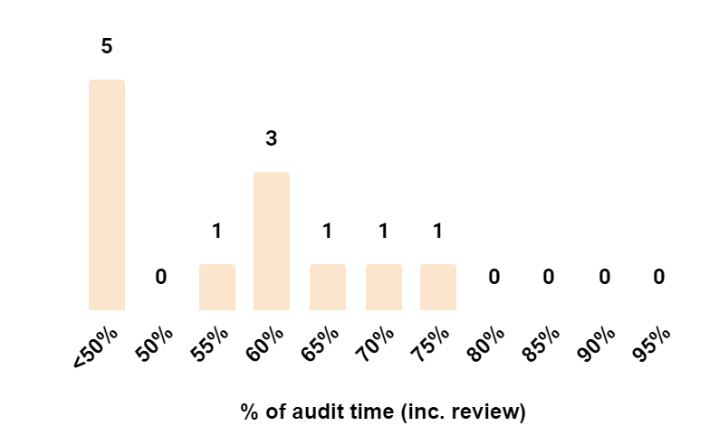
Audit time 63% in the first half of 2021 (56% in Q2)
% Audit Time Distribution [# number of researchers]
%
avg. audit time (incl. review)
1st half of 2021
Q1
70%
63%
Q2
56%
*Smiri and Austin not included in the analysis

Slide 16




Attract and retain the best talent aligned with our mission and culture
Grow team engagement
Develop a clear compensation philosophy
Re-design
hiring process
Enhance performance review process

Slide 17
In Q2 we want to try and test different initiatives to grow team engagement
Virtual Retreat(s)
In person retreat - 2nd half of the year
Team engagement surveys
#Fun / Donuts
Ideas to explore:
Team Members Birthday Celebration
Fireside chats/ask me anything (biweekly)
Speaker Series Interviews (monthly)
Regional retreats (TBD)
Remote Yoga (weekly)
OZ music festivals (monthly)
Virtual office app (TeamFlow)
Any other ideas?
Grow team engagement
Develop a clear compensation philosophy
Re-design
hiring process
Enhance performance review process

Slide 18
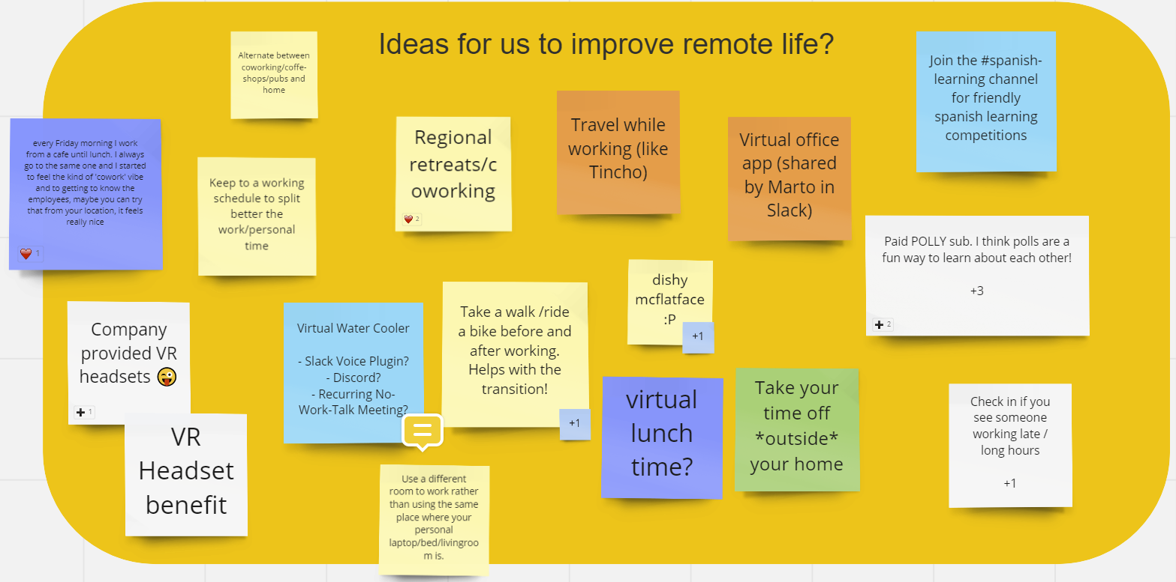
Engagement initiatives - breakout rooms!
Engagement Ideas from virtual retreat
Prioritization exercise
Breakout rooms of 4s: share with your team what things you would like to try and implement [10 min]
Team sharing each group nominee will share what they the ideas they discuss with their group [5 min]
Engagement Initiatives Survey

Slide 19
HR Retro - next week
In the last 4 months we suffered the departure of very valuable colleagues and friends (Caro, Alejo, Igor, Austin, Leo and Andy). We need to have the space as a team to learn for past experiences
Why?
Understand the root cause of each departure to identify what we could have done differently and avoid similar cases in the future
What?
Participation from direct managers and at least one peer of each person who has left
If someone else wants to participate, please reach out to me (we will try to have max 10-12 people so everyone has an opportunity to be heard)
Who?
When?
We will set up the Retro Session next week (Thursday 9pm UTC), and share conclusions with everyone after

Slide 20
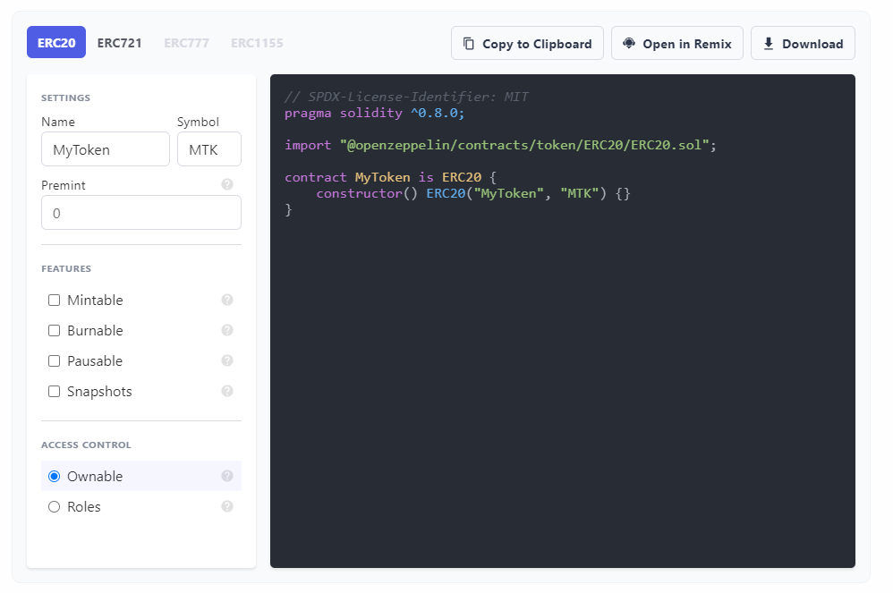
The Wizard has arrived! Also promotes more use of features that Defender does or will support

Slide 21
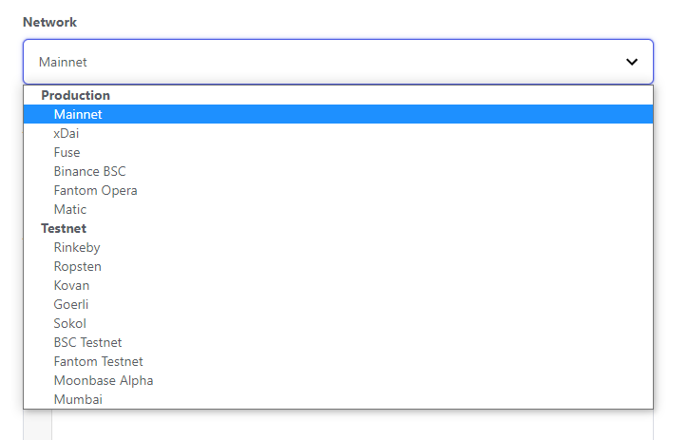
That's a lot of networks! Defender network support list keeps growing based on user requests

Slide 22
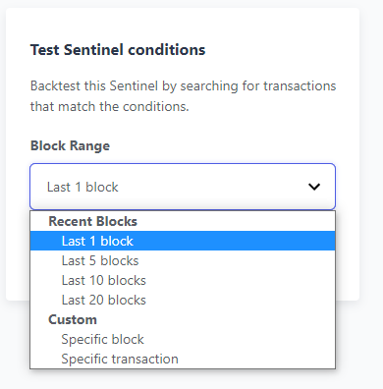
Sentinels can do what now?! Backtest a Sentinel's detection on specific blocks / TXs

Slide 23
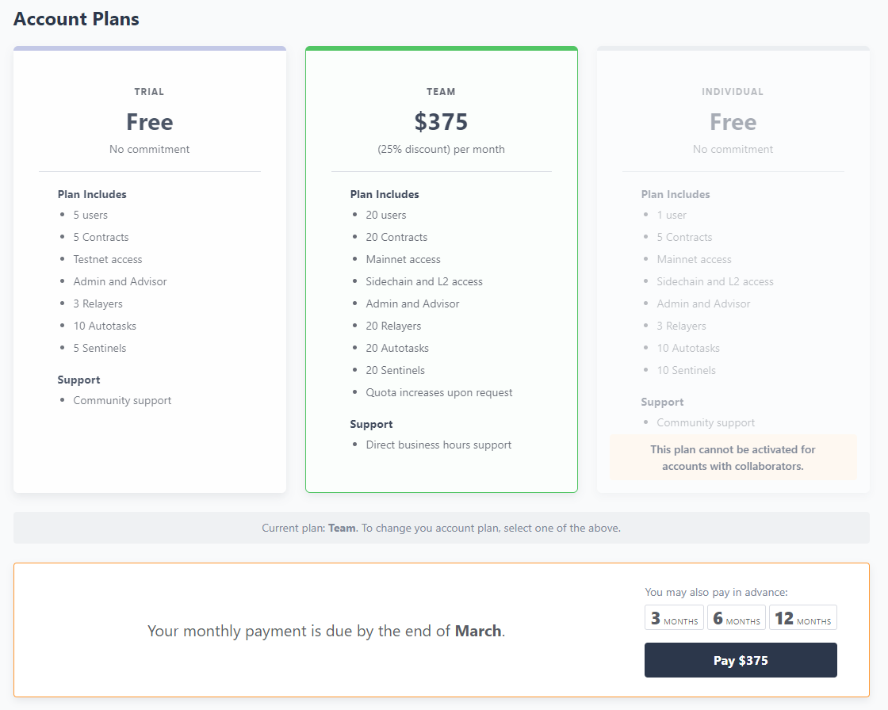
Billing and payments! Integrated with Coinbase Commerce, users can pay up to 1 year in advance

Slide 24
Top tier projects adopting Defender! Goal is to get to 50 paying subscribers by end of Q2
Paid subscribers
Yearn Finance
Balancer
Teller Finance
Yield App
Props / Younow
Fei Protocol
PoolTogether
Notional Finance
Foundation
Opyn
TrustToken
xDai
Other mainnet subscribers
Aave
theGraph
Dharma
Perp.fi
Crypto.com
Optimism
Status.im
Akropolis
Mirror
Trial subscribers
(> 2,000 users now)
Binance
Kyber
Synthetix
UMA
Compound
dYdX
MakerDAO
Armor.fi
Bitski
Mythical Games
Gro
Endaoment
Upshot
mStable

Slide 25
More stuff coming soon! Along with more workshops supporting our integrated product strategy
OZ Defender
Will provide integrated support for Chainlink's new Upkeep service (Chainlink's version of the Keep3r network) launching in April
OZ Contracts
Admin
Will add Timelock support (works with Contracts Timelock Controller) and will add support for easy batching of admin transactions
Will be integrated with Snapshot which many projects are using for off-chain governance
Will add on-chain Governance in collaboration with Compound (building from Compound's Governor Alpha and Bravo) … in future we will also add governance interface for Defender Admin
+
Sentinels
Will allow Autotasks to be used for Sentinel condition checks
Autotasks
Will provide support so that code can query theGraph
Advisor
Will be moving to an open community-contribution model

Slide 26
Agenda
10 min | People & Accomplishments
20 min | Operational Update
10 min | Mission & Strategy Update 👈
10 min | Q & A session

Slide 27
Protect the open economy

Slide 28
OpenZeppelin’s thesis
There will be a trillion dollar open economy built on blockchains and powered by smart contracts
This new, open economy will be built by teams of creative people developing new applications used by billions of people
These teams will need a set of tools, products and services to make sure that what they are building is safe and reliable
OpenZeppelin will be a leading provider of these solutions, allowing teams to build faster with lower risk

Slide 29
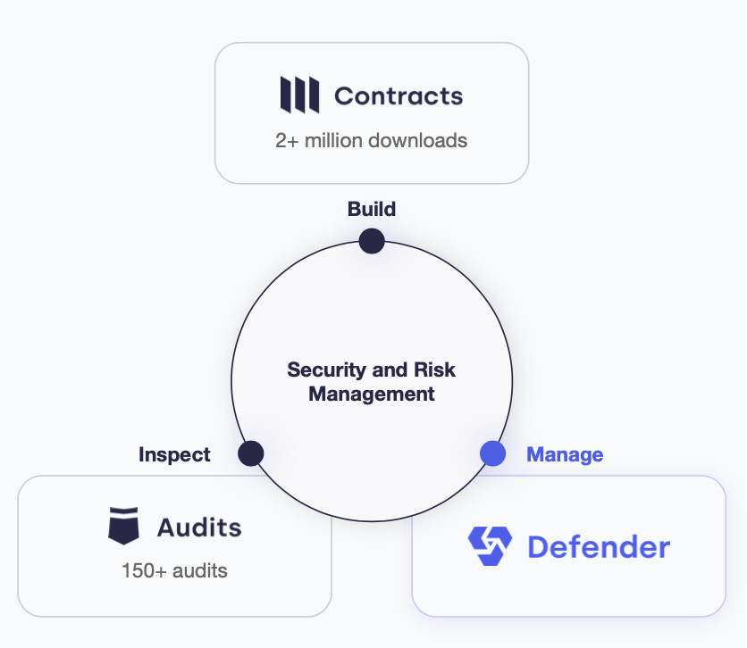
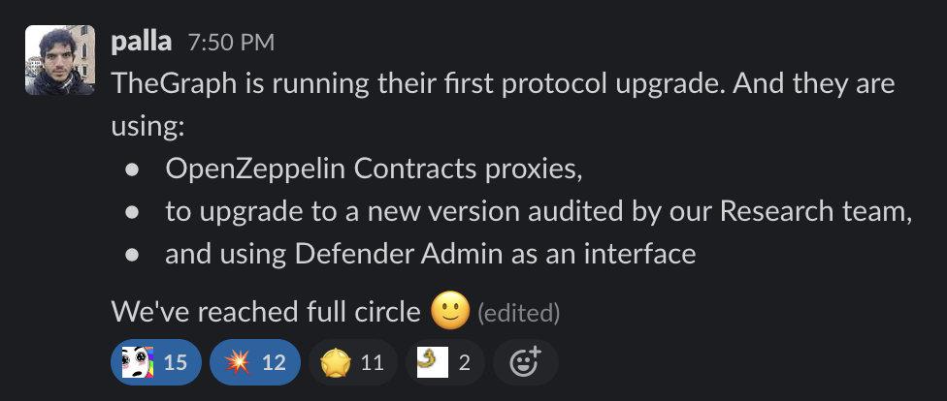
A cohesive offering

Slide 30
